Slide 1

CEIS114 final project
Traffic Control Light System
By Errol Straker
12.20.2020

Slide 2
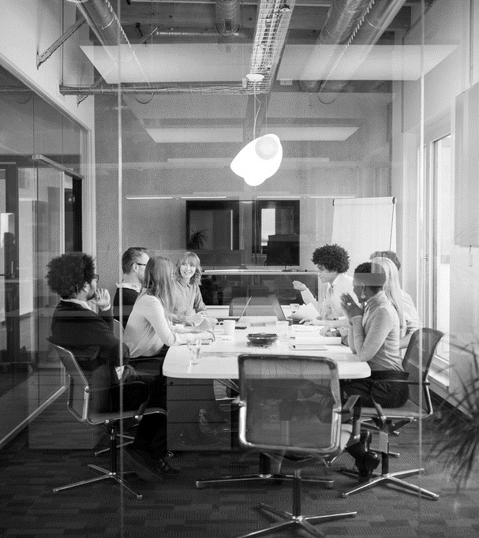
Agenda
PROJECT INTRODUCTION
PROJECT INVENTORY
PROJECT HARDWARE CHECK
BASIC TRAFFIC CONTROLLER
ADDING FEATURES
ADDING EMERGENCY SERVICES AND A MOTION SENSOR
TROUBLESHOOTING
CONCLUSION

Slide 3
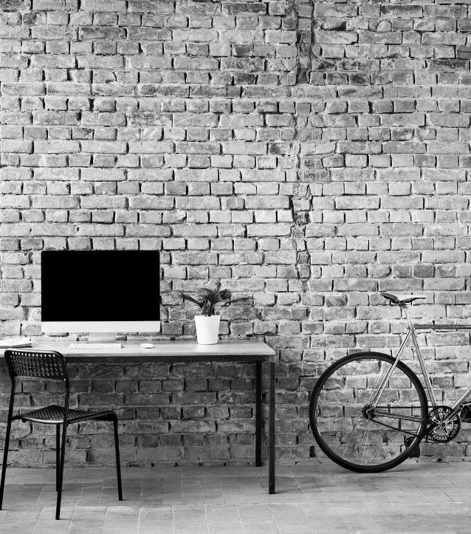
Project
Introduction
During CEIS114 we created a traffic light system. We used a ESP32 board for the basis of our project.

Slide 4
Project inventory
Technology and tools used in this project.

Slide 5
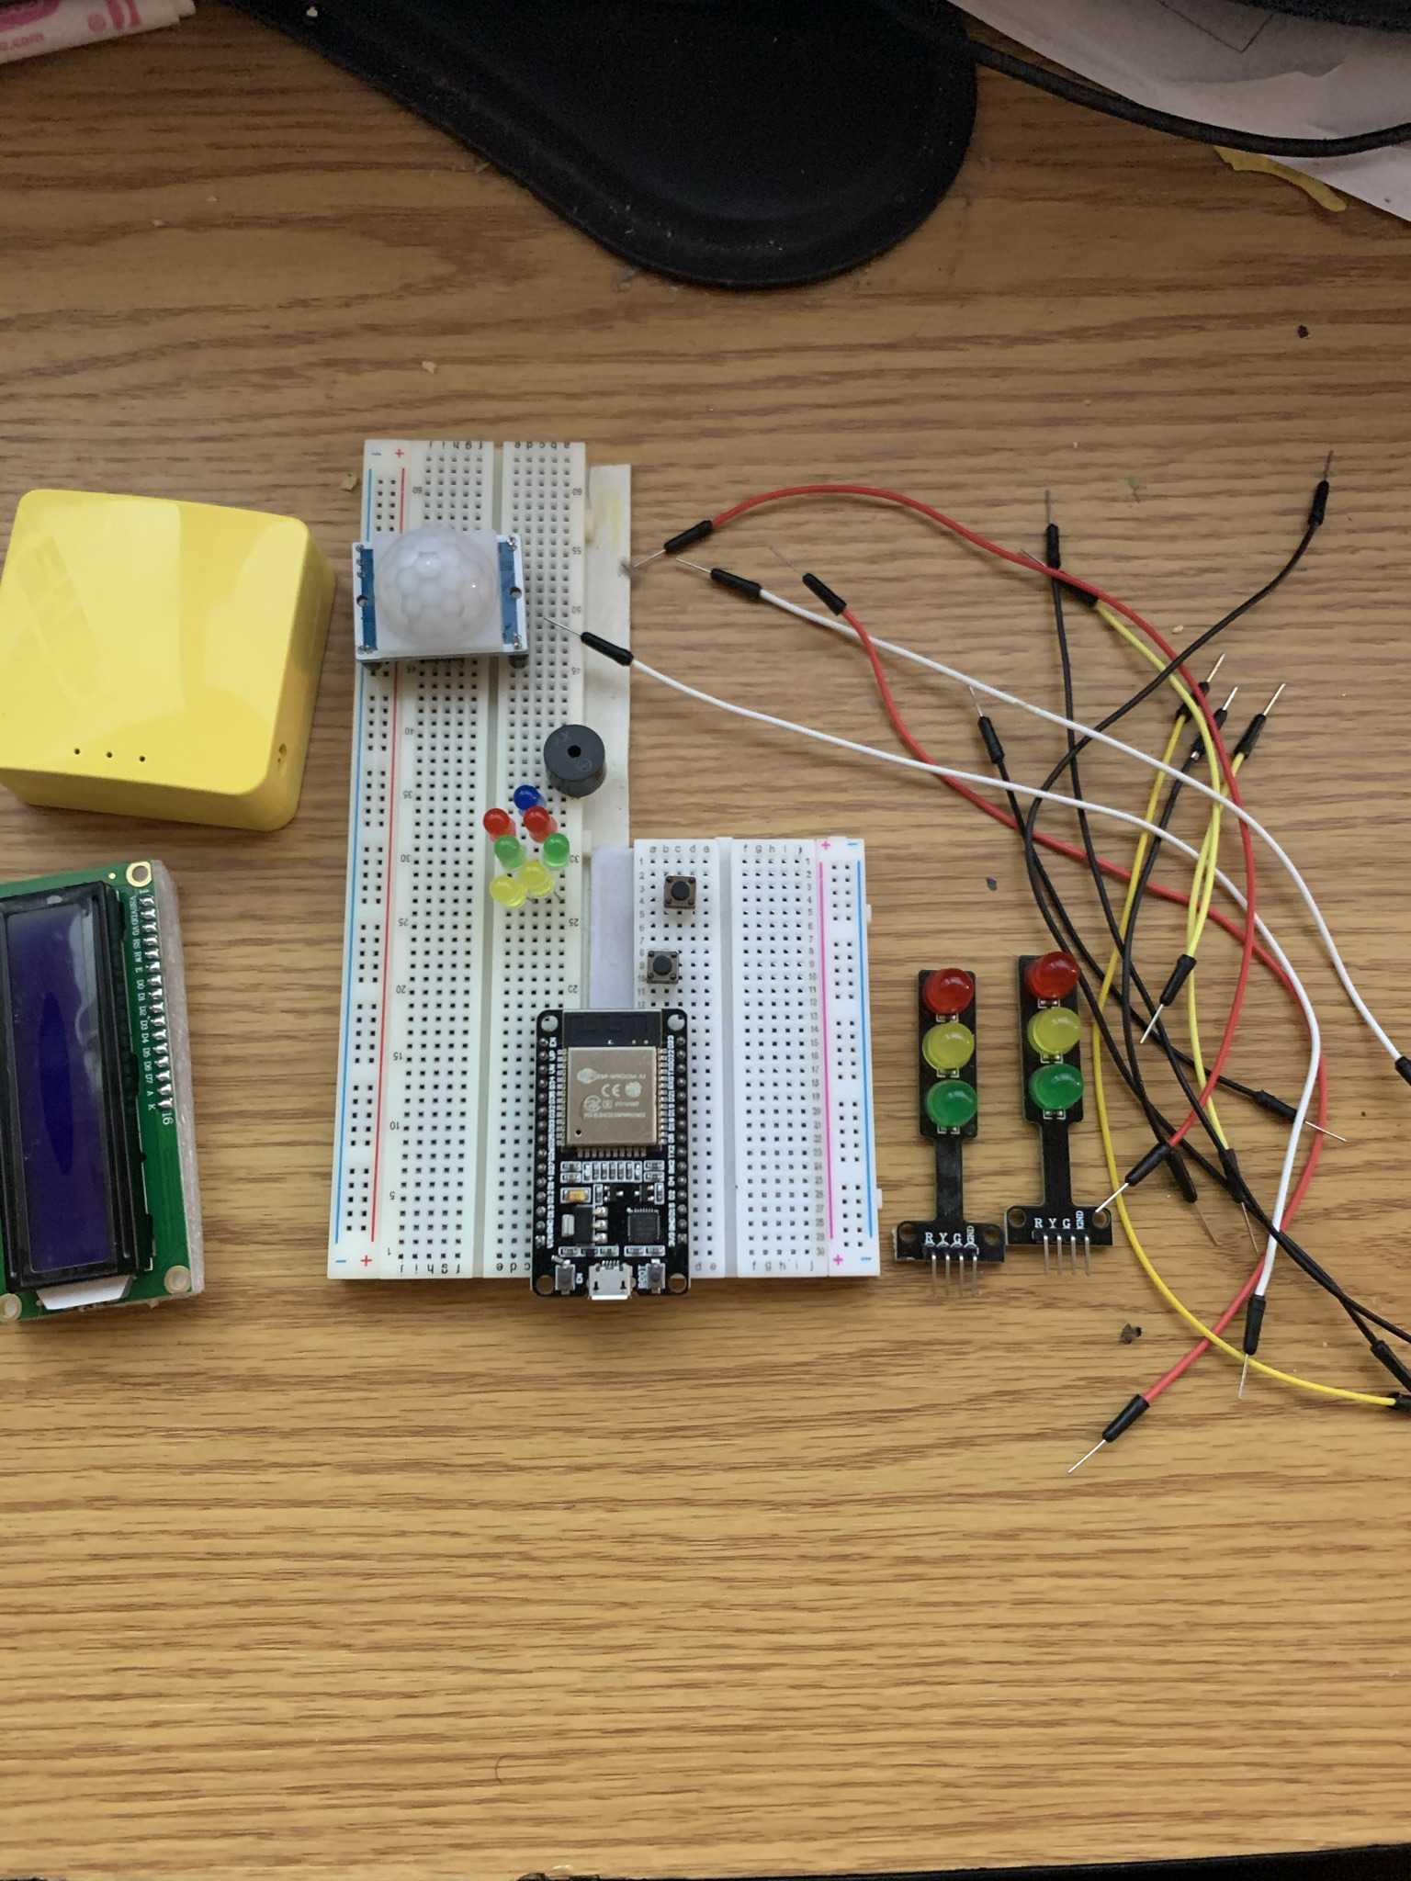
Project Inventory
ESP32 Development Board
Red, Yellow, and Green combination leds
Colored LEDs: Red, Yellow, Green, and Blue
220 Ohm Resistors (optional)
Wires
Breadboard(s)
LCD Unit with I2C Adapter
Active Buzzer
Mini Router
Push Button(s)
PIR Motion Sensor

Slide 6
Project hardware check
Running initial tests on the hardware.

Slide 7
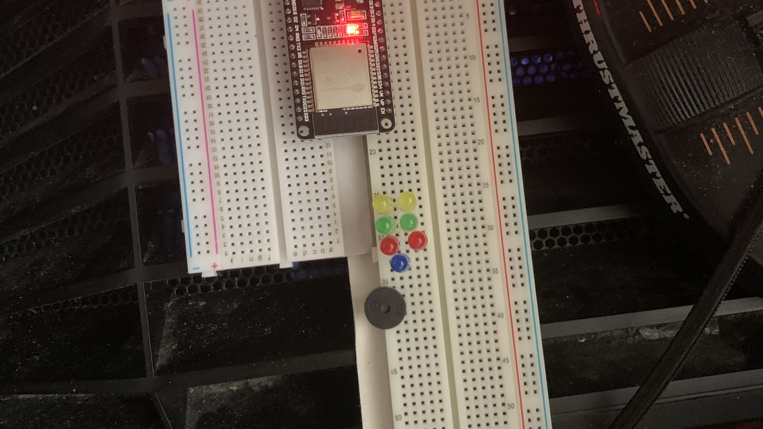
ESP32 Hardware Check
ESP32 Development board mounted on a breadboard and powered on. This is to ensure the ESP32 is working and communicating with the PC.

Slide 8
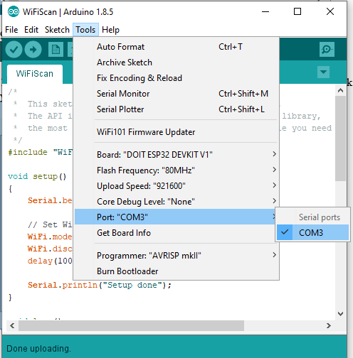
Installation of Arduino IDE
After installing the Arduino IDE. We needed to ensure the IDE is communicating with the ESP32 Development board.

Slide 9
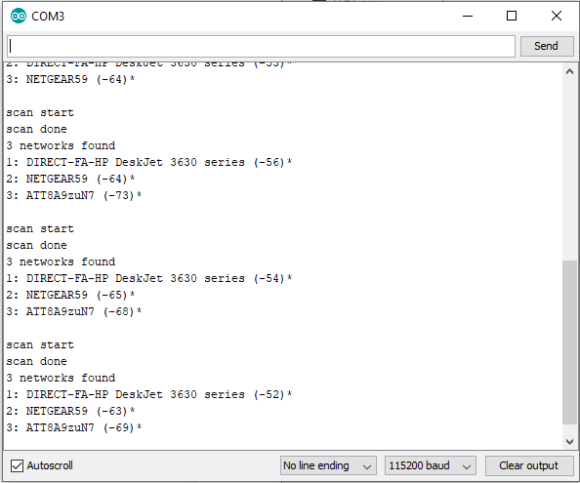
ESP32 Wifi Scan
This is a screenshot of the serial monitor from the Arduino IDE. We used a sample project to enable the ESP32 development board to scan for local wifi networks. This allowed us to complete our testing of the ESP32 Development board.

Slide 10
Basic traffic controller
The foundational design for our traffic control system

Slide 11
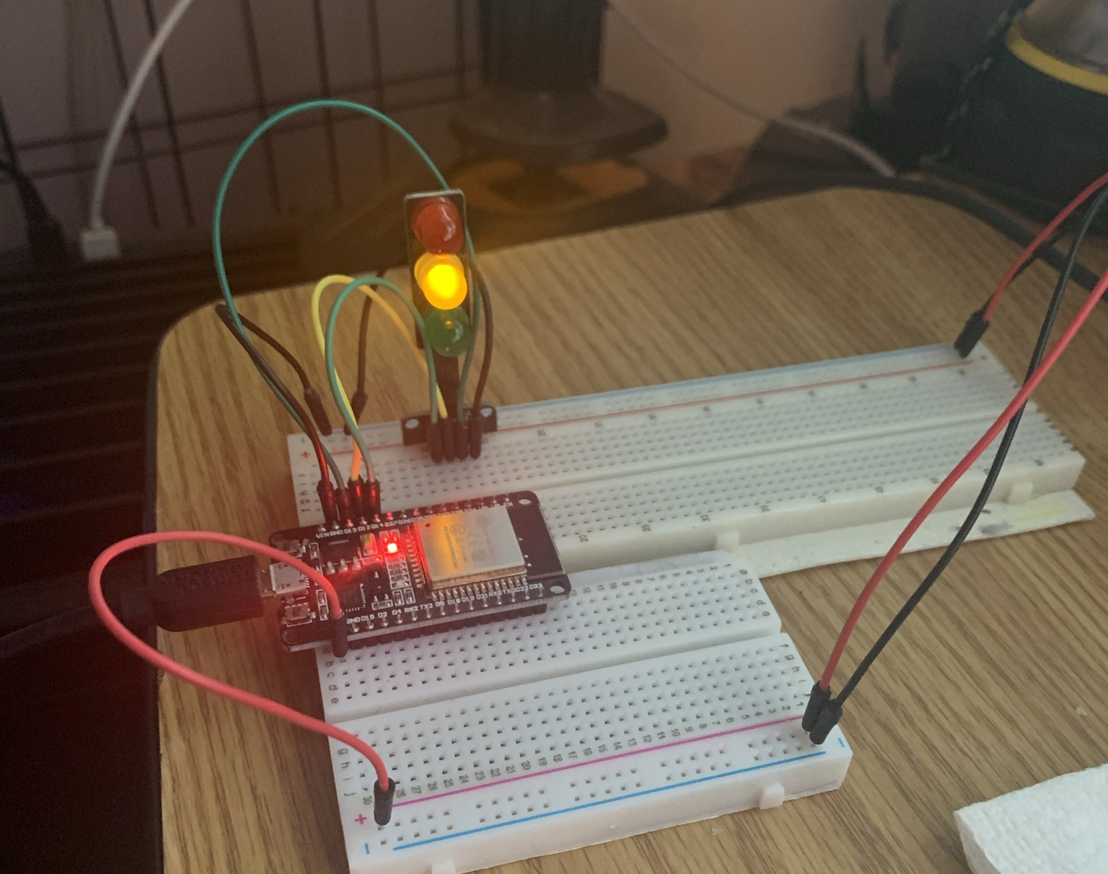
Basic Traffic Control System
This is a picture of the foundational hardware design used for the project. This allowed us to test the LEDs and ensure we are building the circuits correctly. Instead of using single green, yellow, and red leds. I substituted with a combination LED.

Slide 12
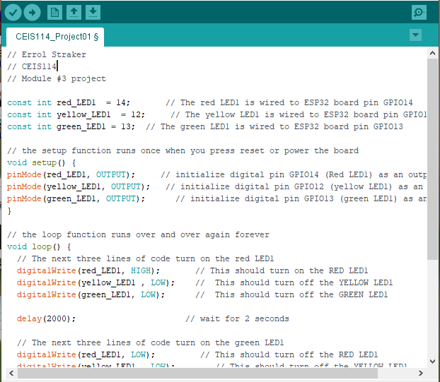
Arduino IDE
This is a picture showing some of the code used in this phase of the project.

Slide 13
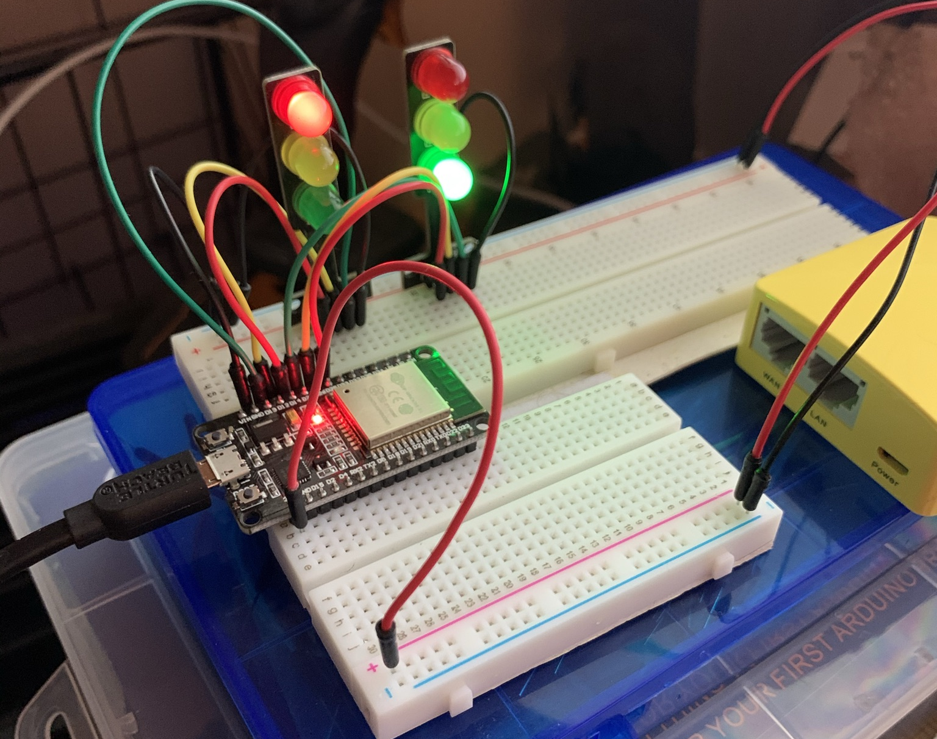
Basic Controller Phase 2
After building a successful controller with one LED. We went on to add on the second set of lights.

Slide 14
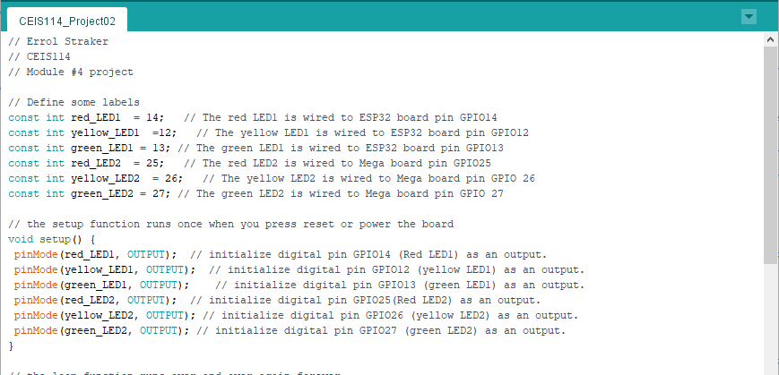
Arduino IDE
This is a picture showing some of the code used in this phase of the project.

Slide 15
Adding features
Building on the basic design. We are now adding in additional features.

Slide 16
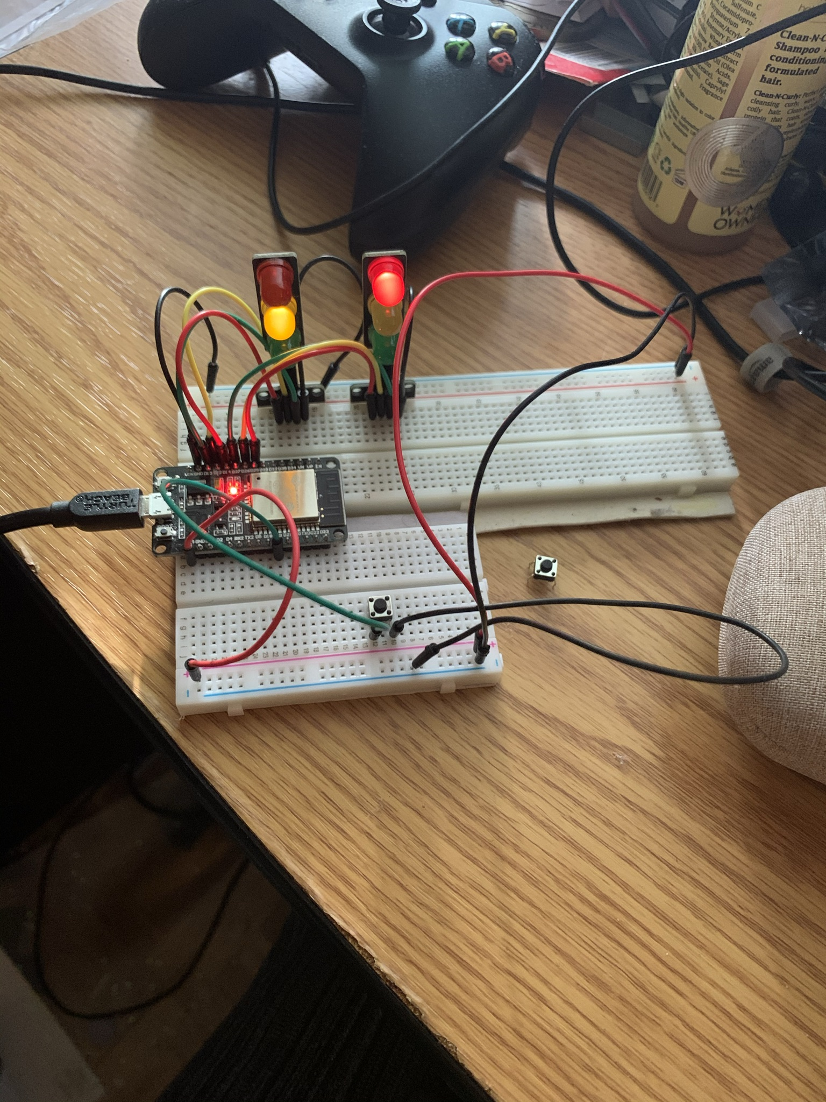
Adding a button
In this phase of the project. We added a button to simulate a crosswalk. This placed the lights in a red position. They held this for ten seconds, giving the user time to cross the street.

Slide 17
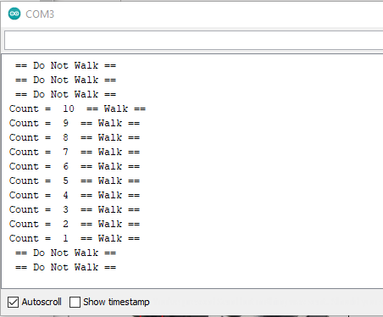
Serial Monitor
This is a picture showing the crosswalk button working as intended.

Slide 18
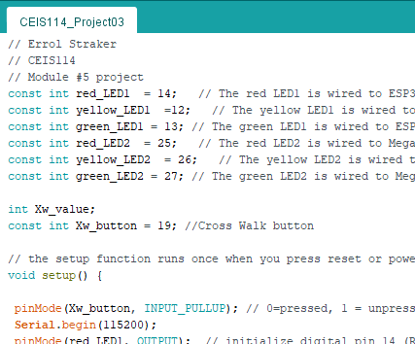
Arduino IDE
This is a picture showing a sample of the code used for this phase of the project.

Slide 19
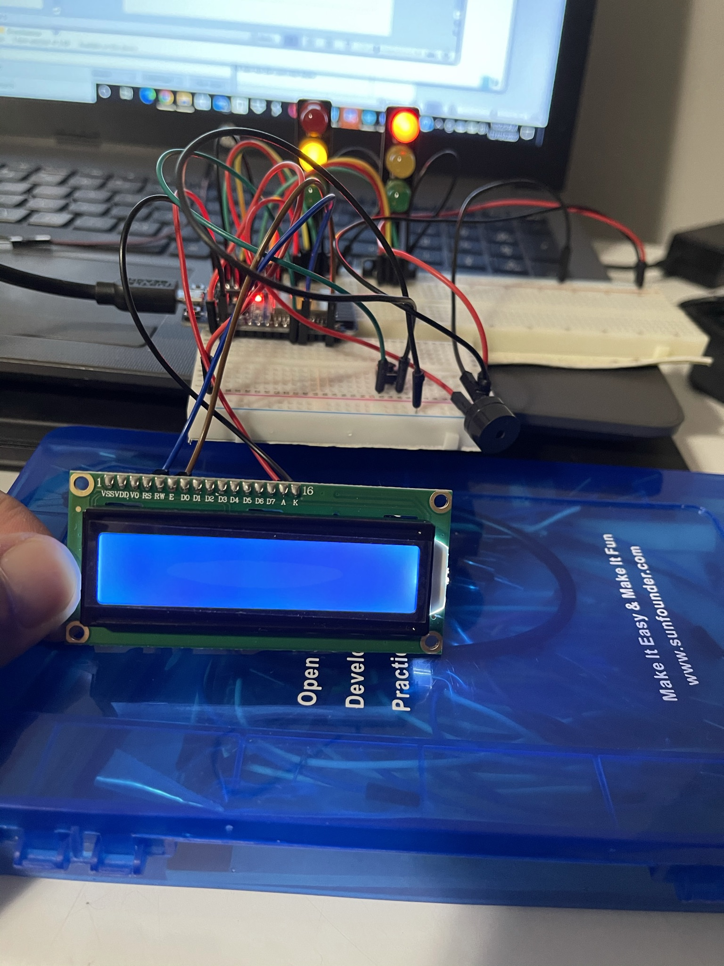
Adding the active buzzer and LCD Screen
For this phase of the project. We added the active buzzer and LCD screen. Unfortunately, my LCD screen did not come with the required controller board. I attempted to make some changes in the project. As a means of getting the screen to work. I was unsuccessful currently.

Slide 20
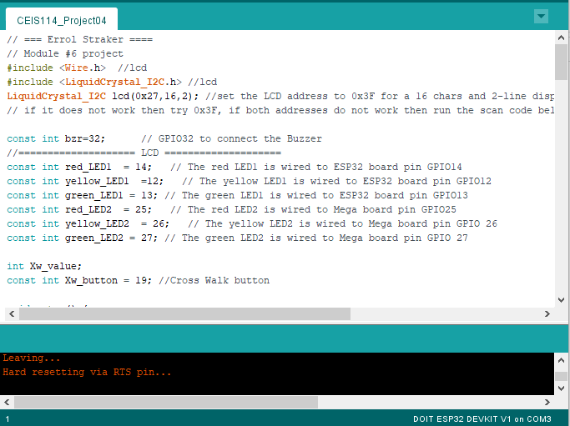
Arduino IDE
This is a picture showing a sample of the code used for this phase of the project.

Slide 21
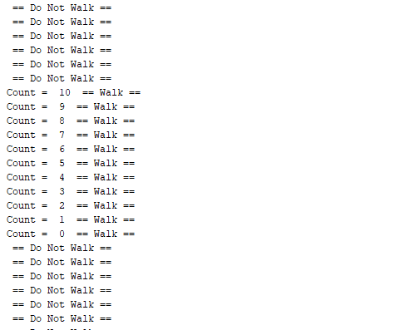
Serial Monitor
This is a picture showing the serial monitor output.

Slide 22
Adding emergency services and motion sensor
The final features we added to the project.

Slide 23
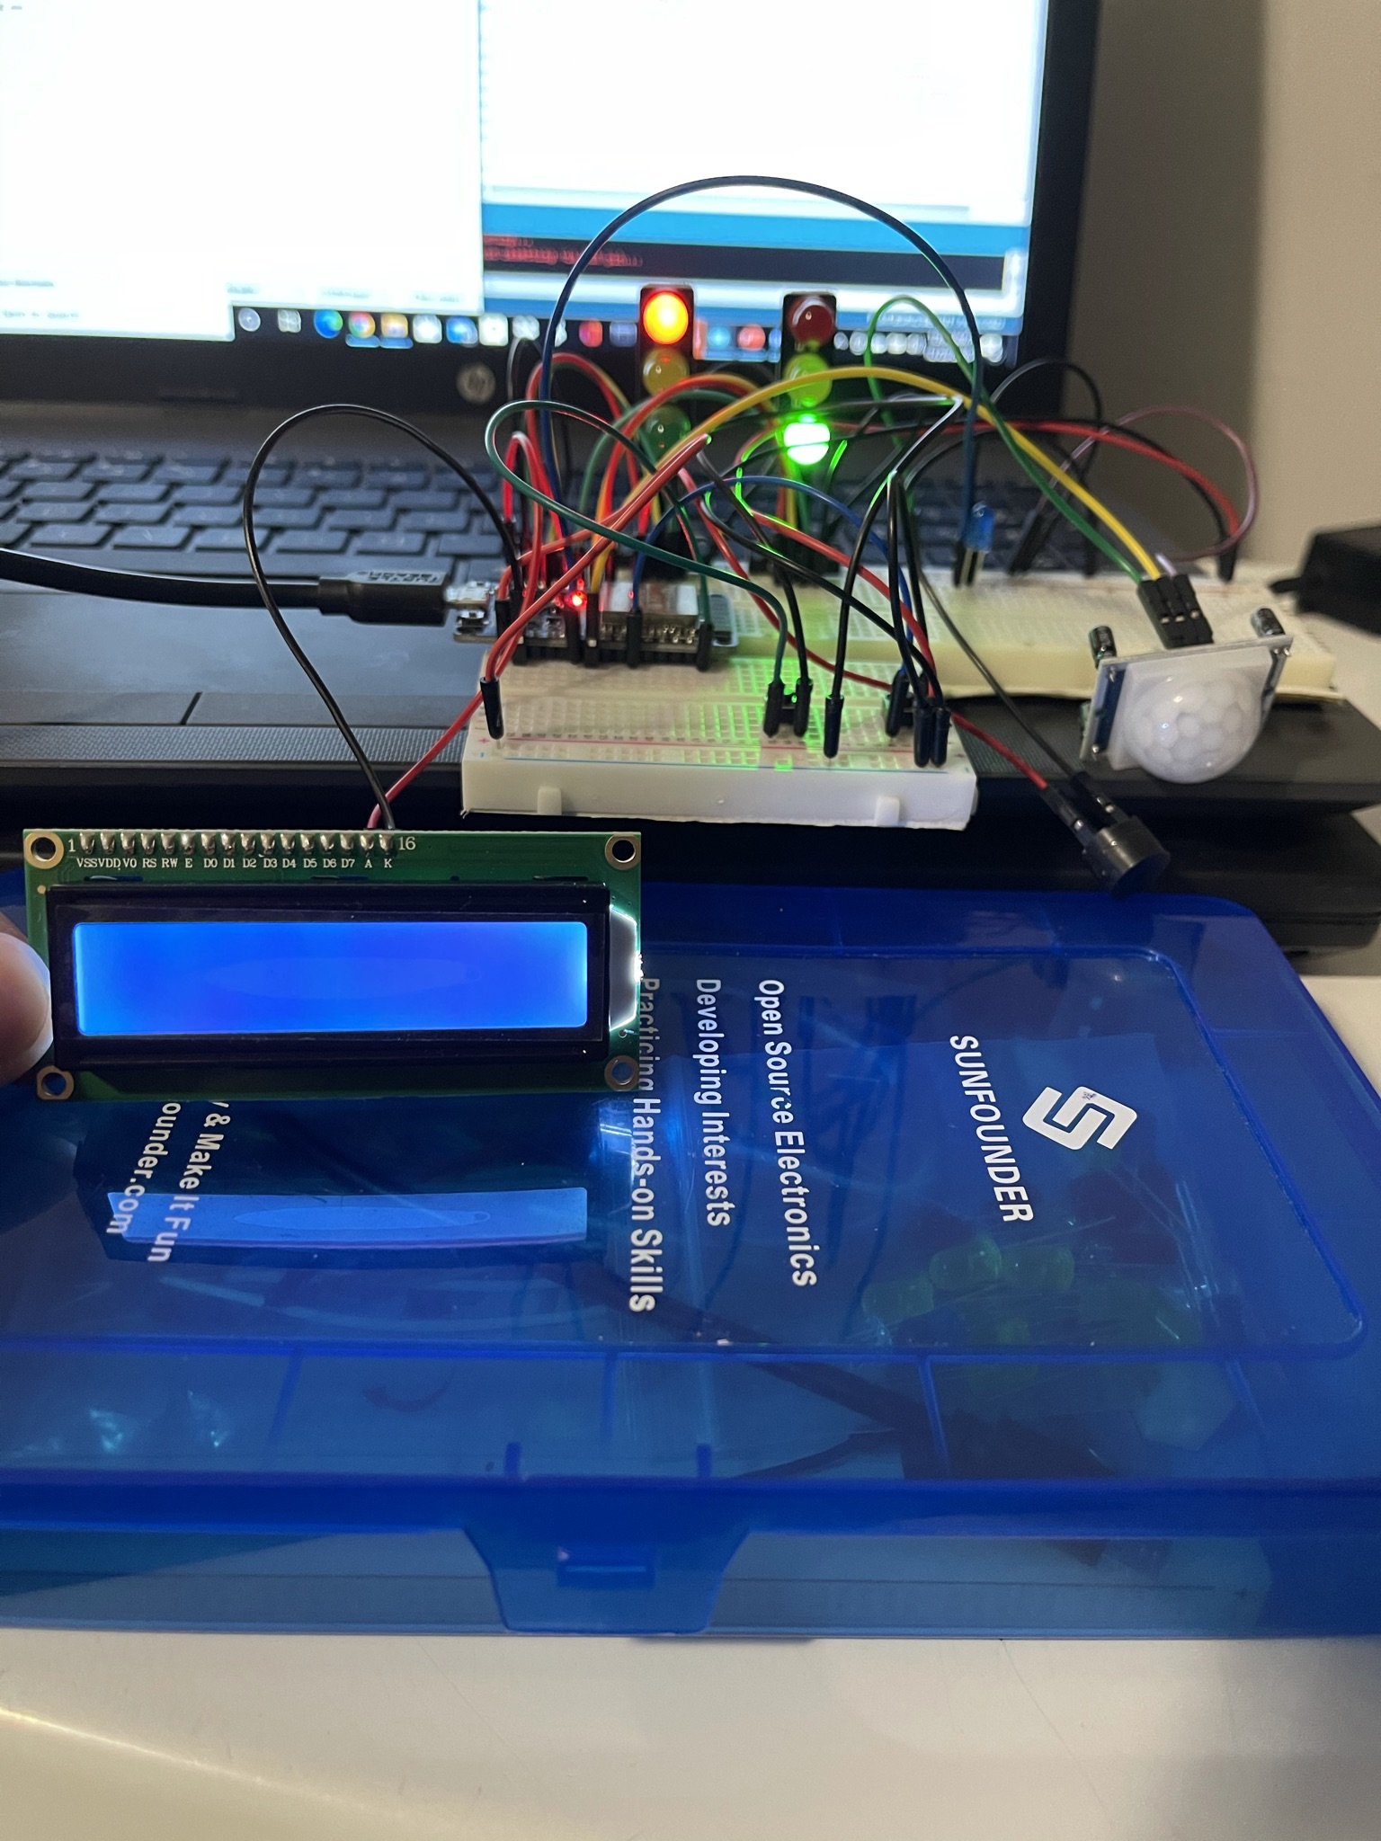
Adding emergency services button and a motion sensor
For the final set of features added to the project. We included a button to trigger an emergency crossing. We also added a motion sensor to detect oncoming traffic.

Slide 24
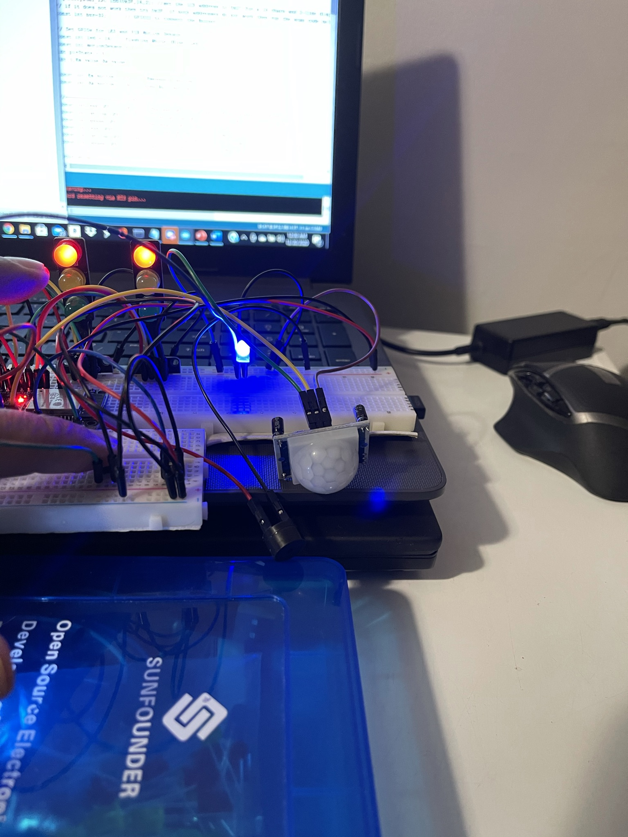
Emergency Services Light
Here is a picture showing the emergency services button in action. Once, pressed the blue light illuminates and message is displayed on the serial monitor.

Slide 25
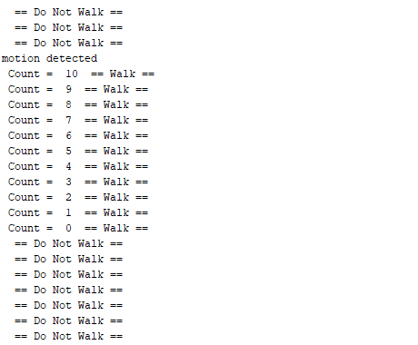
Serial Output
This is a picture showing the serial monitor output

Slide 26
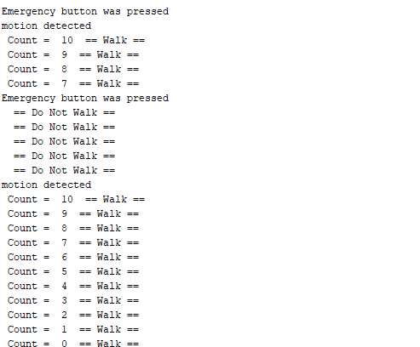
Serial Output
This is a picture showing the serial monitor output

Slide 27
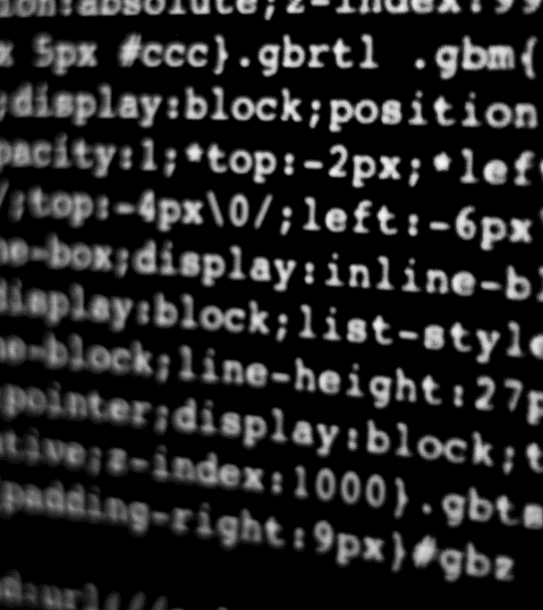
Project Challenges
The next set of slides focus on the challenges I faced during this project.

Slide 28
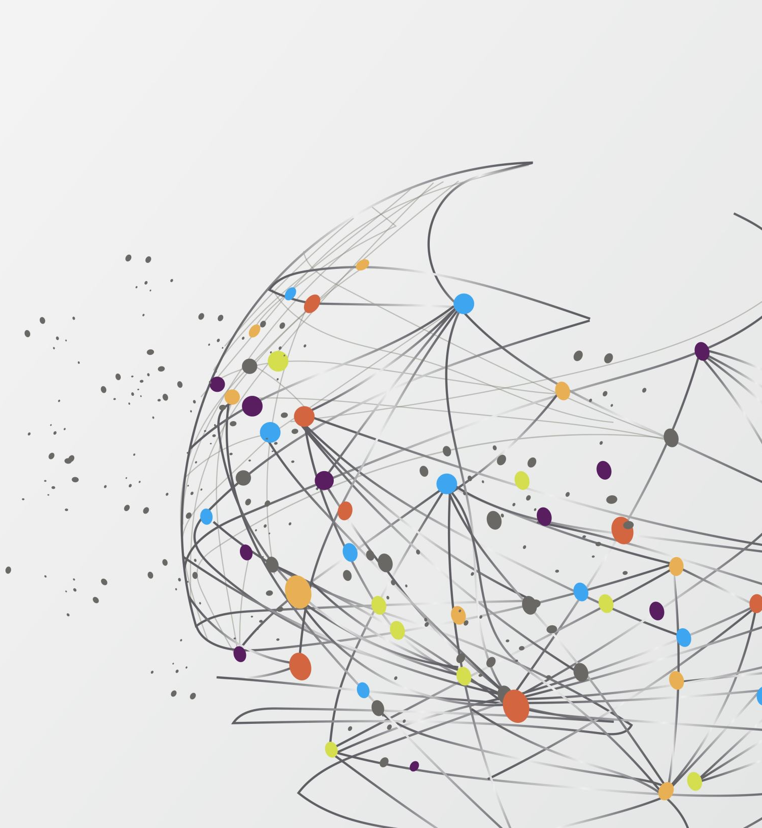
Troubleshooting
Week 1 Challenges: (Basic Traffic Controller Section)
ESP32 board not connecting to computer nor allowing me to choose a port. After doing some research I found a forum at ESP32.com (https://www.esp32.com/viewtopic.php?t=5841). Here there were a few different solutions discussed. After doing some reading and review of my equipment. I determined that my USB cable, while useful for charging phones, is not the correct cable for communication with my ESP32 board.
Week 5 Challenges: (Adding Features Section)
The serial monitor was not displaying the correct output. I initially thought I created the circuit incorrectly. Ten minutes later, that included reading the code to make sure there were no hidden errors to fix. I realized, the button was not working and replaced it. That is why I have two buttons in the picture.

Slide 29
Troubleshooting
Week 6 Challenges: (Adding Features Section)
My LCD screen did not come with the controller board. I looked through all the materials I received in the kit. I attempted to look up online how I could complete the project, without the controller. I managed to power on the screen, however, I quickly realized the level of code I would have to change in order to rewire the LCD screen for the project. I simply did not have enough time to complete the level of work needed.
This ESP32 board I started the project with started to malfunction. When I attempted to upload the new set of code. I kept getting an error message. Please, find a picture of the error message on this slide. Thankfully, I purchased some additional ESP32 boards a personal project. The board pictured is the one that gave me all the trouble. I thought I damaged it when I tried getting the LCD screen to work.

Slide 30
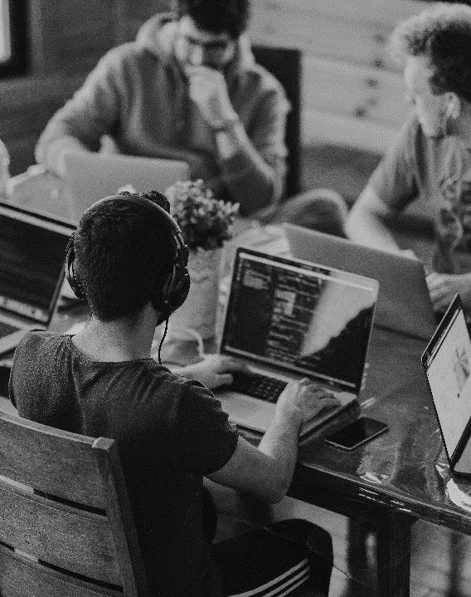
Conclusion
This project allowed me to build a working example of a real-world solution. The skills I gained from this class have allowed me to further my IoT journey. The code and skills demonstrated here can be used on the job.

Slide 31



THANK YOU
Errol Straker
+1 (312) 519-8748
errol.strakerjr@gmail.com
WWW.ERROLSTRAKERJR.COM

