Slide 1
CEIS101
IoT Alarm System

Slide 2
Hi, my name is Errol Straker
During this presentation I will cover the process I went through in creating an IoT alarm system
I touch bases on:
Challenges
New skills I have learned

Slide 3
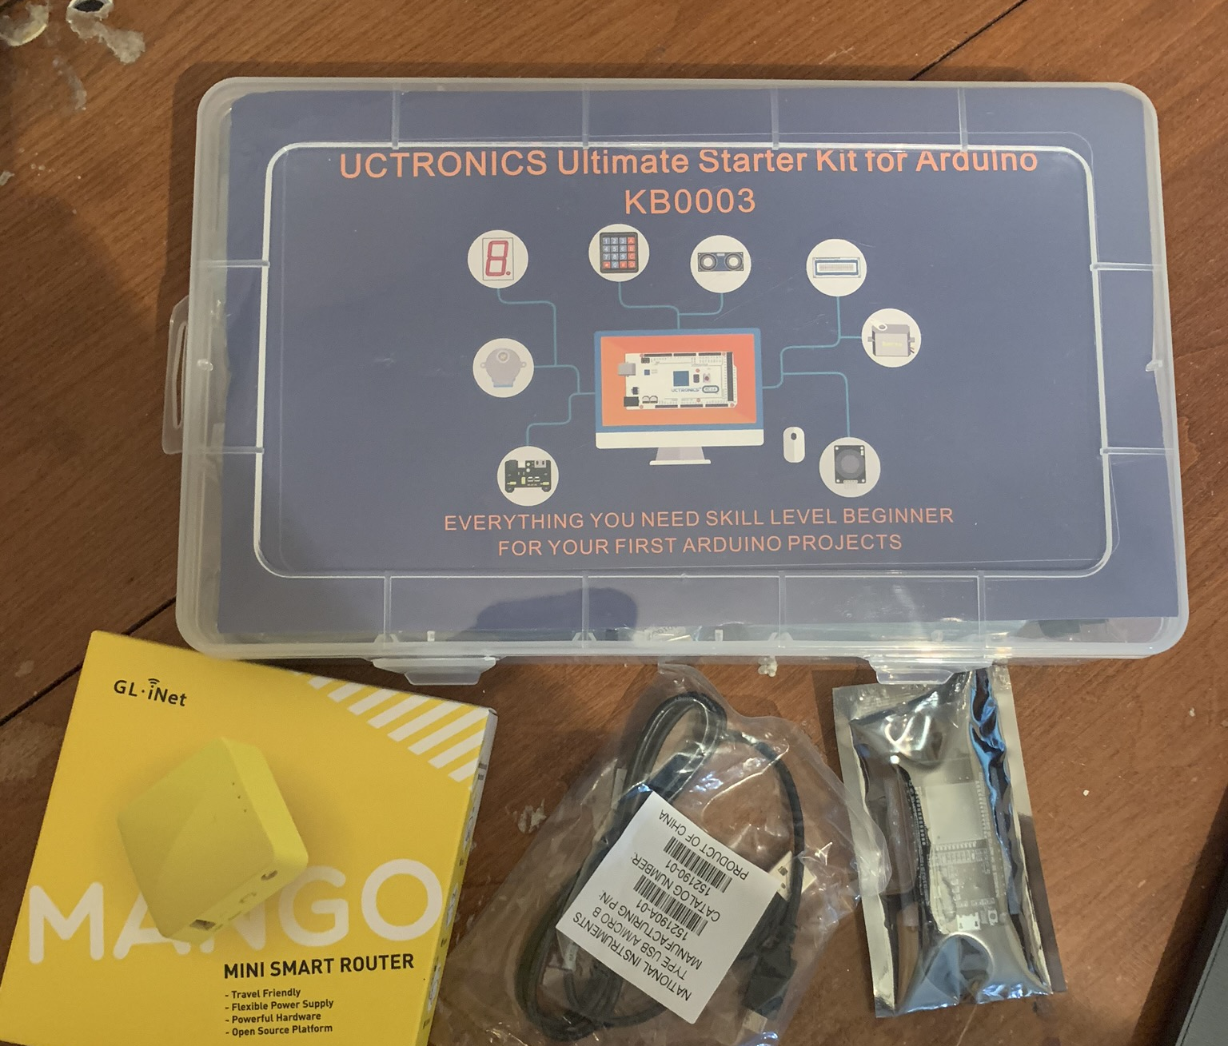
IoT Inventory
For this class and project we used the Arduino starter kits and laptops provided by DeVry.

Slide 4
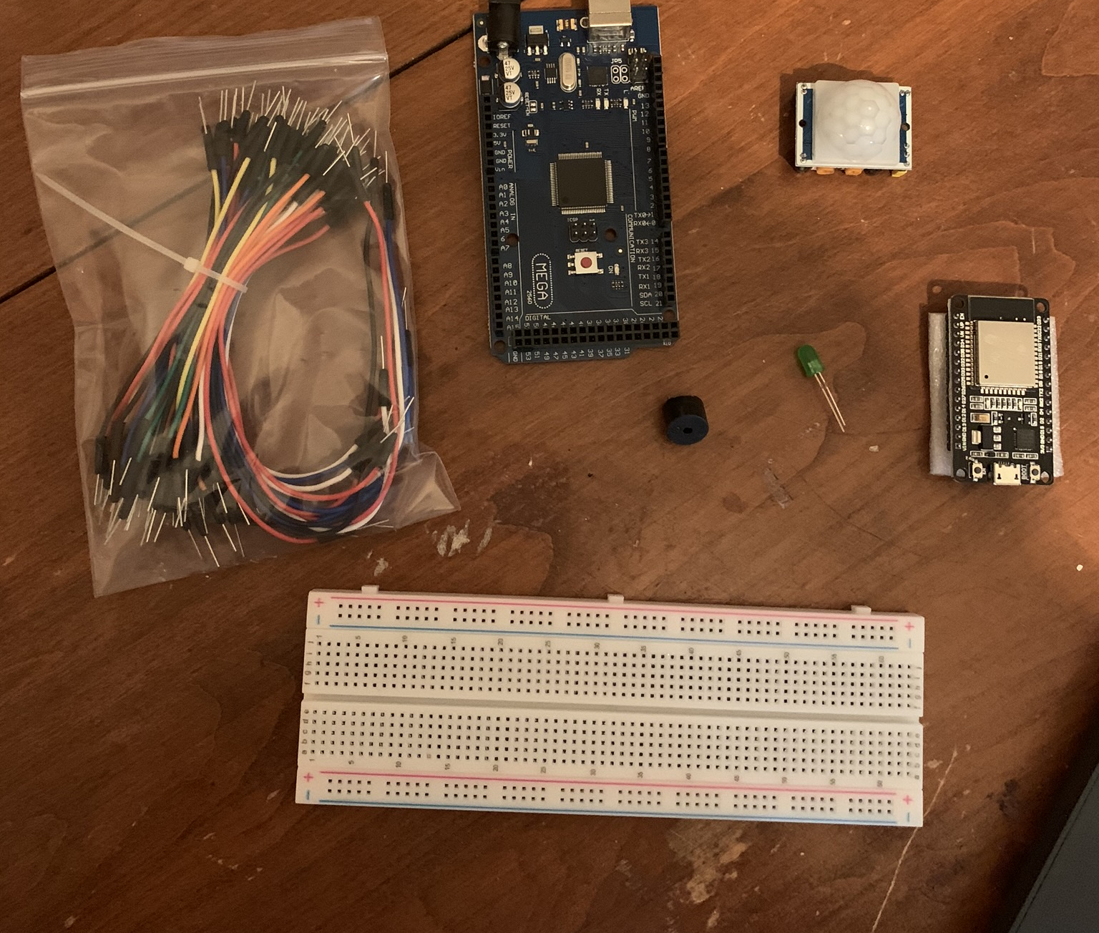
Parts Inventory
This picture is displaying the core hardware for the alarm system. Along the way there were several added parts.

Slide 5
Flowcharts
For our project we needed to create a flowchart. Flowcharting the processes allowed for me to develop my project in a more streamlined way. The next slide is an example of some of questions asked during this section of our class, about flowcharting.

Slide 6
Who uses Flowcharts
Research flowcharts
What companies use flowcharts?
Answer here: Many companies use flowcharts for example Underwriters Laboratories, IBM, Google, Chase Bank, and many others.
Why might they use flowcharts?
Answer here: At Underwriters Laboratories flowcharts are used for many different purposes. However, they are all related to the same under line reason. To map out a process and show the wanted out come. Whether its creating a computer program or designing a new way to test a product. Flowcharts are used to show a process and how it should flow.

Slide 7
Input – Processing - Output
Fill out the following chart
Input | Process | Output
Motion | Process motion from sensor | Buzzer or light goes off

Slide 8
Flowchart
Flowchart with three shapes

Slide 9
Our first circuit for class
To start off our project we needed to create a blinking light. For me this was a first, as I always wanted to learn how to use an Arduino. I was rather excited to get this experience and to learn how I can leverage embedded technologies.

Slide 10
Blinking LED
This is the first circuit we created for class using the Arduino
The light did blink, no video unfortunately

Slide 11
Building the alarm system
Once the blinking LED test was successful, I had the IoT bug
So I decided to move ahead and work on getting the motion sensor to work, I have shared the test code in the next slide

Slide 12
Motion Sensor Test code

Slide 13
Layout of the motion sensor
There was a slight problem with my code, the motion sensor did not work. Since our professors did not covered this as of yet. I looked up the motion senor’s layout to properly hook it up.

Slide 14
Motion Sensor Challenge
Once I was sure the motion sensor was connected correctly. It still was not working. It turns out there is a delay just before the hardware is ready to use. To remedy this issue, I added in a light to let me know when the motion sensor would be ready. The next slide is a picture of my motion detector.

Slide 15
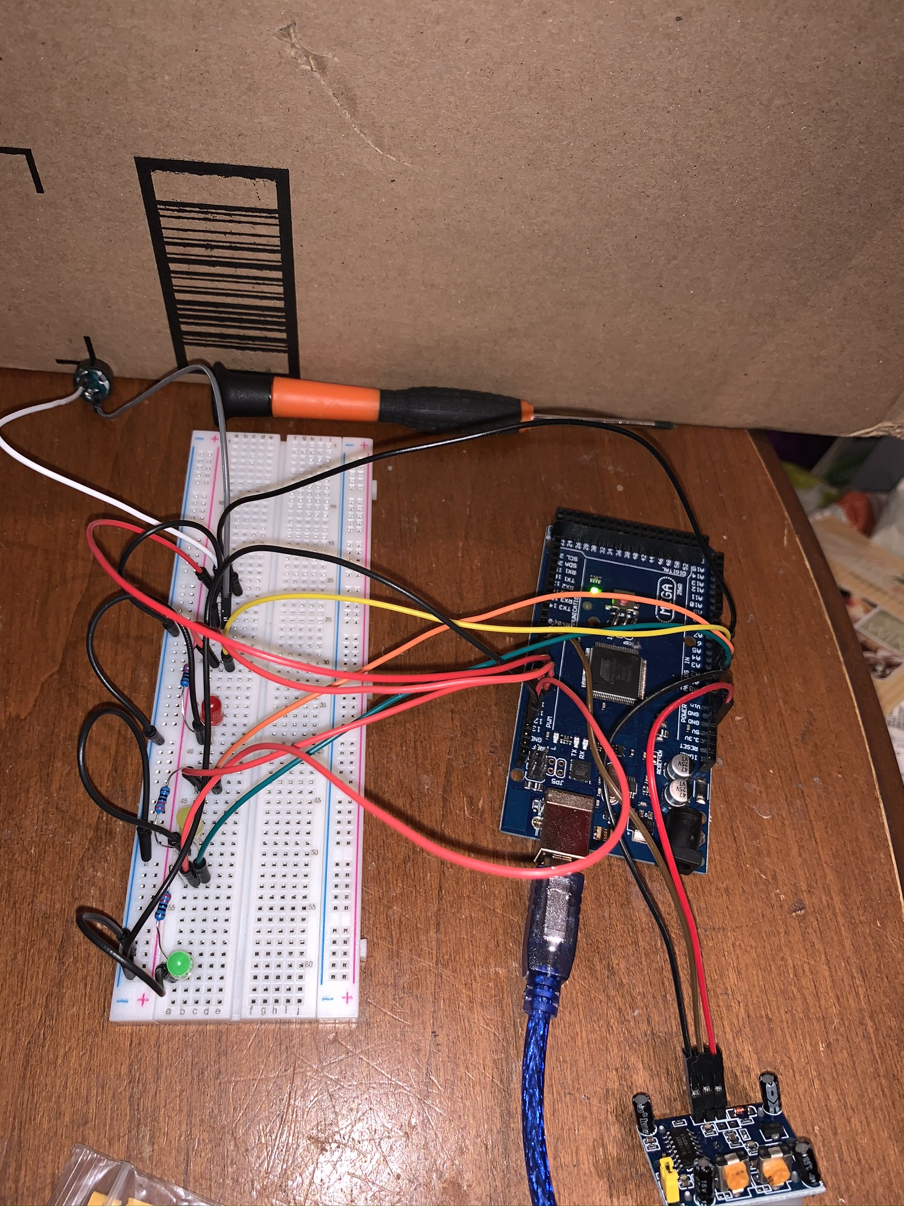
Motion Detector with Ready light
This is a picture of alarm system with the motion sensor, buzzer, ready, pause, and stop light.
The code is shown in the next couple of slides

Slide 18
Code Explanation
The code uses DELAY to allow the motion sensor to reset
The pauLight is a yellow light used to single the system is resetting
The following slide is code explanation used in our class

Slide 19
Code explanation
Review the code
What pin is the input pin? What pin is the output pin? How do you know?
Answer here:
Input Pin: 7
Output Pin: 10, 11, 12, 13
In my code I defined them as input or output pins using OUTPUT and INPUT
How many times does the Arduino IDE setup() function run?
Answer here: It only runs once.

Slide 20
Displaying our data
The next part of our project involved displaying out data to the serial console
Along with displaying the data we also were required to display how much voltage was being used by our Arduino
This could be used for diagnostics purposes; this was awesome to learn!

Slide 21
Circuit (Picture or video)
Motion sensor circuit with new resistor

Slide 22
Displaying data and voltage challenge
Originally, we only needed to have one light. Our professor encouraged us to add another light. Well, I already added three lights by this time and wanted to track the power consumption of each light. This presented a unique challenge as I had to figure not only how to wire this up. I also needed to know when to show the data and display a name for with the circuit being tracked. The next set of slides displays both the console and code used for this potion of the project.

Slide 23
Serial monitor (Screenshot)
Screenshot of serial monitor showing voltage difference and count of motion detected.

Slide 24
First section of code

Slide 25
Second section of code

Slide 26
Third section of code

Slide 27
Fourth section of code

Slide 28
Setting up a Router and ESP32 board
For the last portion of our project we needed to setup a router and a ESP32 Development Board
This honestly took the longest to do and I thought the board was broken
It turned out the board was not in a mode to except my code. Once I resolved the problem I was able to complete the project

Slide 29
Router (Screenshot)
Setup page for configuring the router
Screenshot of router setup page

Slide 30
Circuit (Picture or Video)
Picture of circuit with ESP32 board on breadboard with LED

Slide 31
Web page (Screenshot)
Picture of the webpage showing the LED on and off links.
Web server screenshot showing turning on and off the light from the web.

Slide 32
Conclusion
The introduction to computer technology course has allowed me to learn and build on a number of new skills. This is just the beginning for me using embedded technology and displaying the projects I will create.

